Slide 1
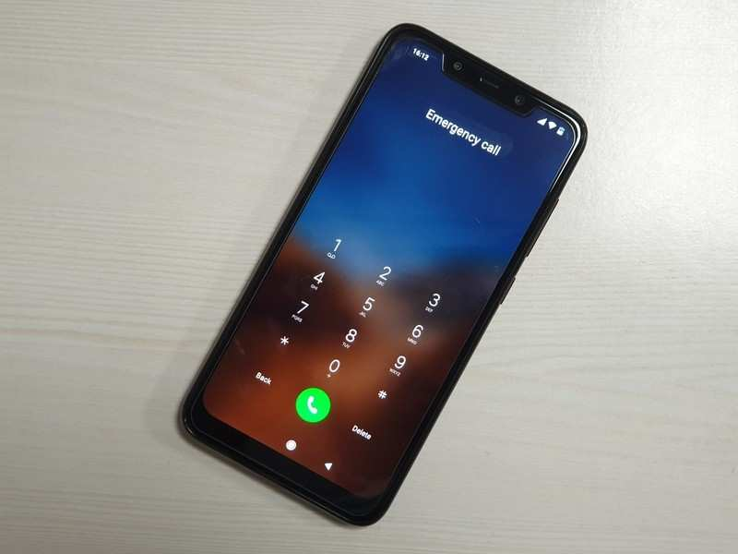
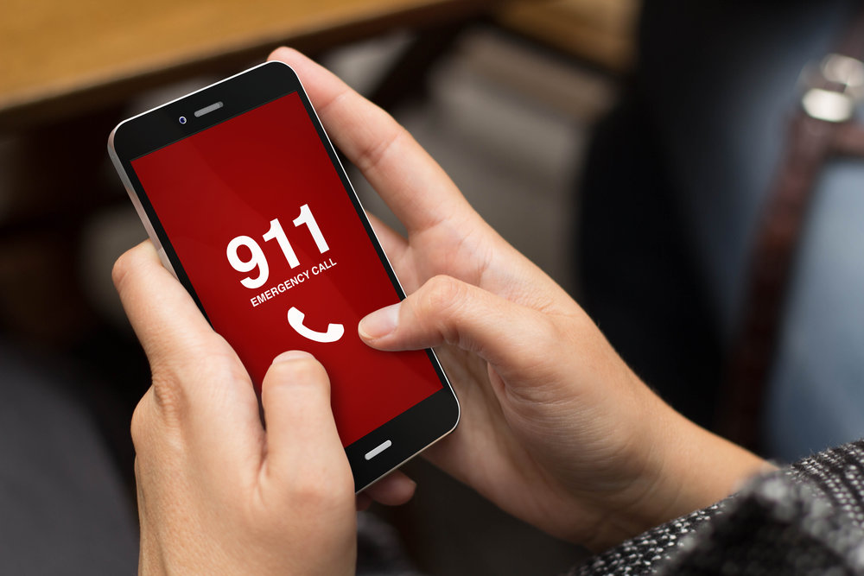
Emergency Speed Dial

Slide 2
Project Description
This project is based on the fact that the average lifespan of a human is increasing and more and more people are surviving till their old ages. Contrary to this the distance between people keeps increasing both psychologically and physically. Hence, the elderly often find themselves in situations where they need help but don’t have the people to help them.
Our project is also based on the fact that the emergence services call lines in India far from efficient and honestly difficult to remember during the time of an emergency. We have a different number for everything be it from the police or the fire brigade and they are also quite similar. For example, while 103 is the emergency number for the traffic police during an road accident, 104 is the hotdial for a certain network provider.

Slide 3
GOAL
Our app will try to make calling the services you need easier. In simple terms it is a speed dial software that will have all the number saved in them in case of emergency. This is to streamline the process and to compile all the emergency numbers in a single, easy-to-use software.
The goal is quite similar to that of the American emergency number 911. Even Though it’s the american emergency number it is known through the world due to its efficiency and easy to use nature which has saved several people already in the past. It is considered to be one of the standard when coming to emergency contacts as it is simple and efficient as it compiles all the different emergency numbers into one easy to remember number.

Slide 4

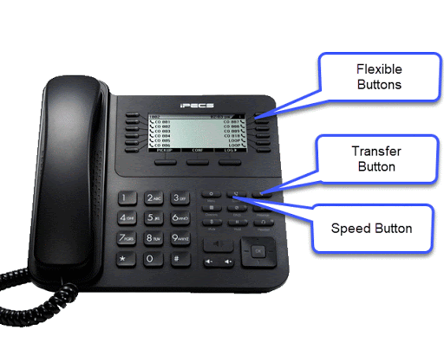
FUNCTIONAL REQUIREMENT
Easy to use software
Must show signal strength
Call connection should be quick
Location must be shown and recorded

Slide 5
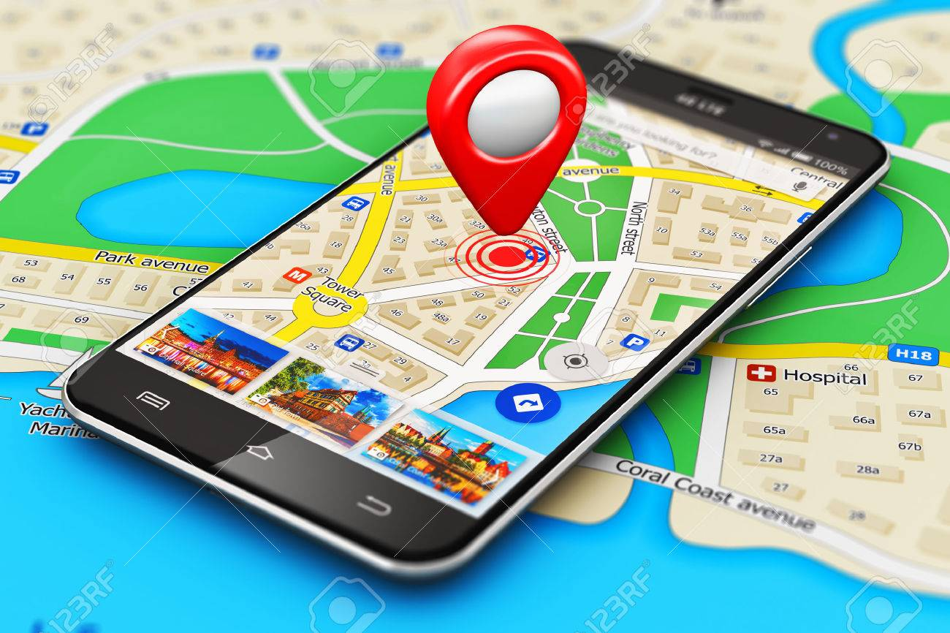
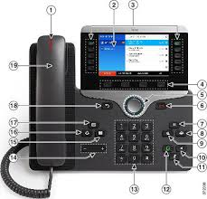
NON FUNCTIONAL REQUIREMENT
Application should be available for 24 x 7
Registration service should be scale to serve 1000 request per sec over 5 minute timespan
Data of the user should be secured
Calling time should be less
Location Service should be accurate

Slide 6
Scope
S.NO | IN SCOPE | OUT SCOPE
1 | Gps to transmit location | System to record location to transmit
2 | Basic software skeleton | High level interactive software
3 | Interactive UI | Software capable of sending call
4 | Calling system and location system | No signal calling

Slide 7
STAKEHOLDERS
Stakeholder | Responsibilities
Finance Head | Approve and regulate use of money for he project
Head of marketing | Regulate the market to record and boost the want for th software
Head of Software Development | Lead the software developer team to make sure of a smooth production process
Project Lead | Lead and project and communicate and settle dispute between stakeholder

Slide 8
WBS AND PROJECT SCHEDULE
S.No | Activity | Assigned | Start Date | End Date | Status
1 | Project management | Sima Bharti | 31.01.2021 | 31.12.2021 | Done
2 | Fronted coding | Ratnangsu | 10.2.2021 | 19.9.2021 | On-Going
3 | Backend coding | Ratnangsu | 10.2.2021 | 19.9.2021 | On-Going
4 | Finance | Harsh | 28.01.2021 | 10.10.2021 | On-Going
5 | Marketing | Harsh | 30.01.2021 | 29.10.2021 | Done

Slide 9
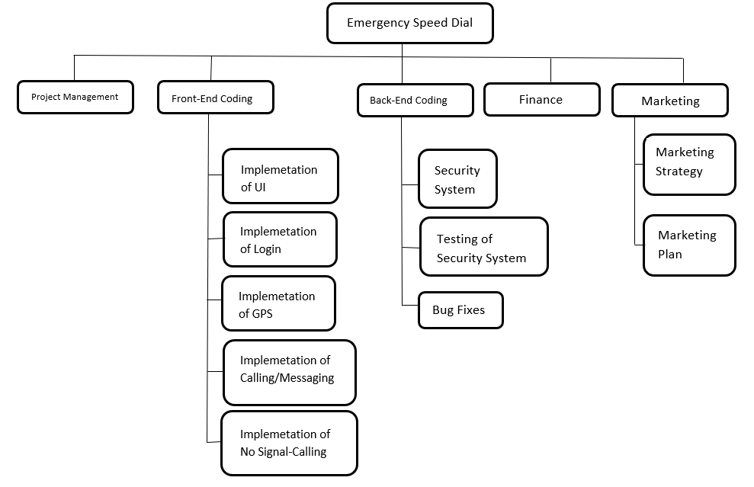
WBS AND PROJECT SCHEDULE

Slide 10
PROJECT PLAN
In this project we have planned the activities based on agile model for rapid project development. The primary focus areas of the project management are
Integration Management - Preparing the team to accept roles and responsibilities according to the interest
Schedule Management - Designing ,Developing ,Testing and Implementing are scheduling activities
Cost Management - Preparing cost estimates
Quality Management - Quality assurance and quality control measured primarily through user recommendations
Resources Management - Managing project hardware requirements

Slide 11
PROJECT EFFORTS
Activity | Activity Description | Subtask Description
E1R1A1 | Design The User screen | Making of UI Implementation of UI Making of Login Screen Designing of the Main Screen
E1R1A2 | Technology Used | Various Software To Make the Project More Easier Python for coding Sketch for UI/UX Design
E1R1A3 | User Charge | One time cost taken from stakeholders

Slide 12
Roles and Responsibility
Name | Role | Responsibility
Sima Bharti | Project Manager | Manage the project
Harsh Tiwari and Ratnangsu | Frontend Developer | Develop user interface
Ratnangsu and Sima Bharti | Backend Developer | Design, Develop and Unit Test service
Harsh Tiwari and Sima Bharti | PR and Content | The member will focus on direct promotion of brand and build content for the purpose of educating audience

Slide 13


Risk Analysis And Management
Risk Management
All information may get leaked Securing Data
User location may get leaked Better Security Encryption
Login issue Proper Server Maintenance
No signal for emergency call Better Signal Acceptance

Slide 14
Design Architecture

Slide 15
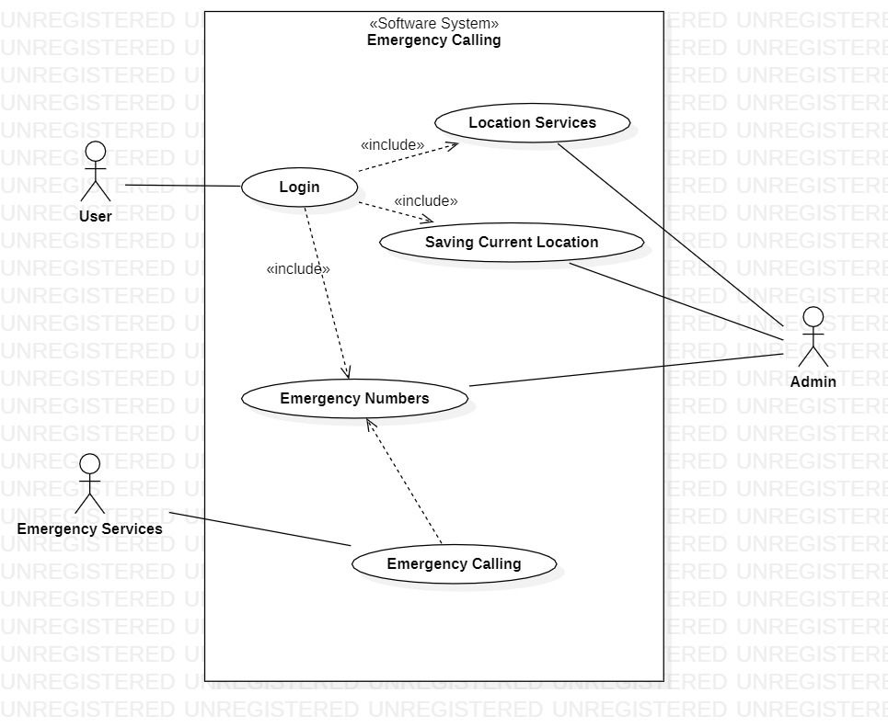
Use Case Diagram
The user first logs in using password and User ID. After logging in the location services is turned on
and the software starts recording the user’s location. The user after login has the option to call
emergency services and all the calls are recorded for future use. Only the Admin has access to these
information.

Slide 16
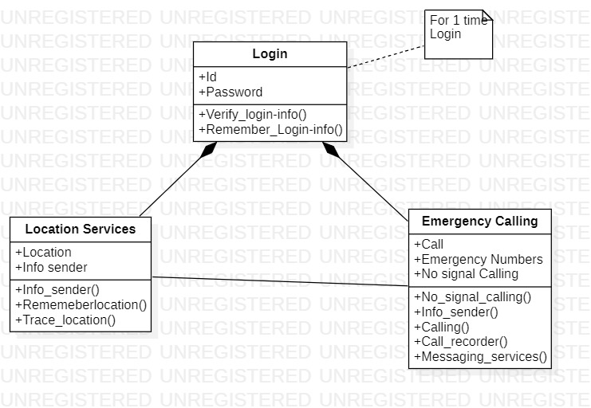
Class Diagram
The user first Logs in using the ID and password which is then verified and the device is remember
for ease of future use and no need for further logins. Once login is done the location services is
turned on and the location is saved all time. When the user decides to call the Emergency Services
the call starts getting recorded and gets saved in the server and location is send to the required
Authorities.

Slide 17
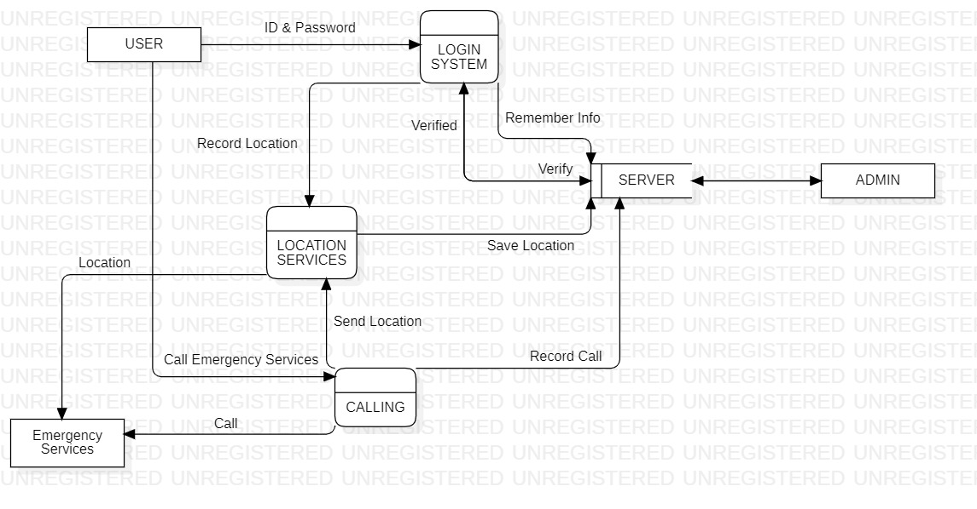
DFD Diagram
The user first Logs in using the ID and password which is then verified from the server and the device
is remember for ease of future use and no need for further logins. Once login is done the location
services is turned on and the location is saved in the servers. When the user decides to call the
Emergency Services the call starts getting recorded and gets saved in the server and location is send
to the required Authorities.

Slide 18
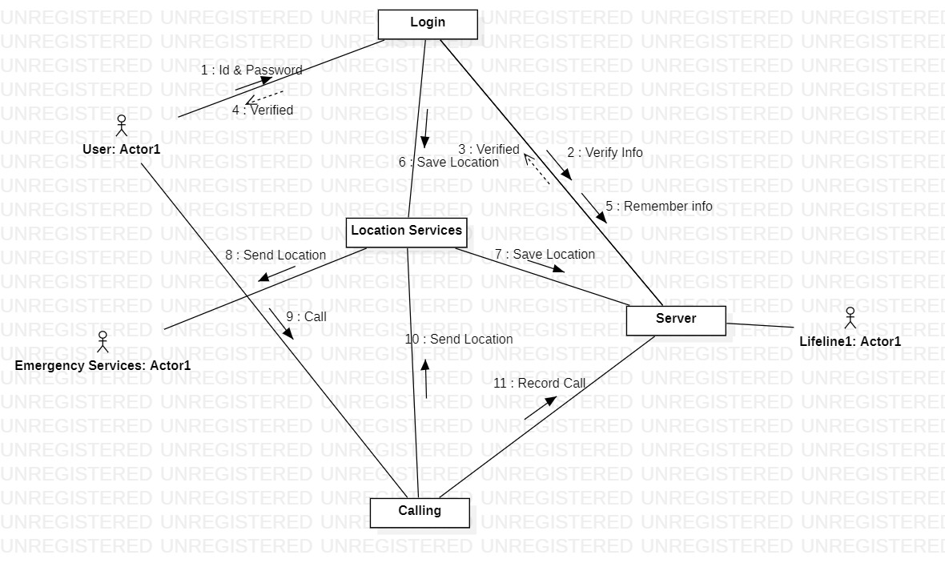
Collaboration Diagram
The user first Logs in using the ID and password which is verified from the server. Once Verified message is sent, the location services is turned on and the location is saved in the servers. When the user decides to call the Emergency Services the call starts getting recorded and gets saved in the server and location
services retrieves the location from the server and sends it to the required Authorities.

Slide 19
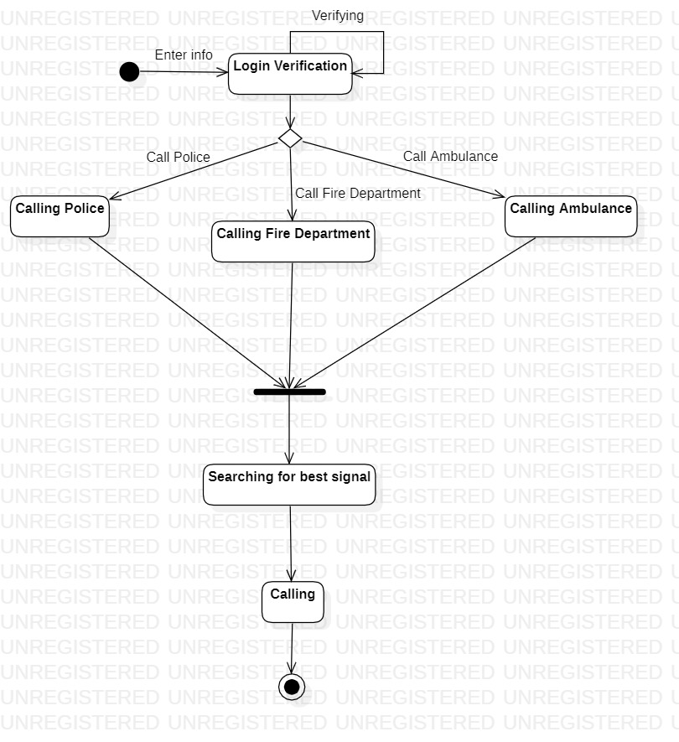
State Diagram
State Diagram
First the system is in idle state. When it is turned on it will first ask login password and ID. There one
will have the option to create a new account. Once it is logged in it will remember the information and
login automatically for ease of access in an emergency situation. Once logged in the user will have the
option to call the required emergency services. Once selected it will search for the best signal and
connect the call.

Slide 20
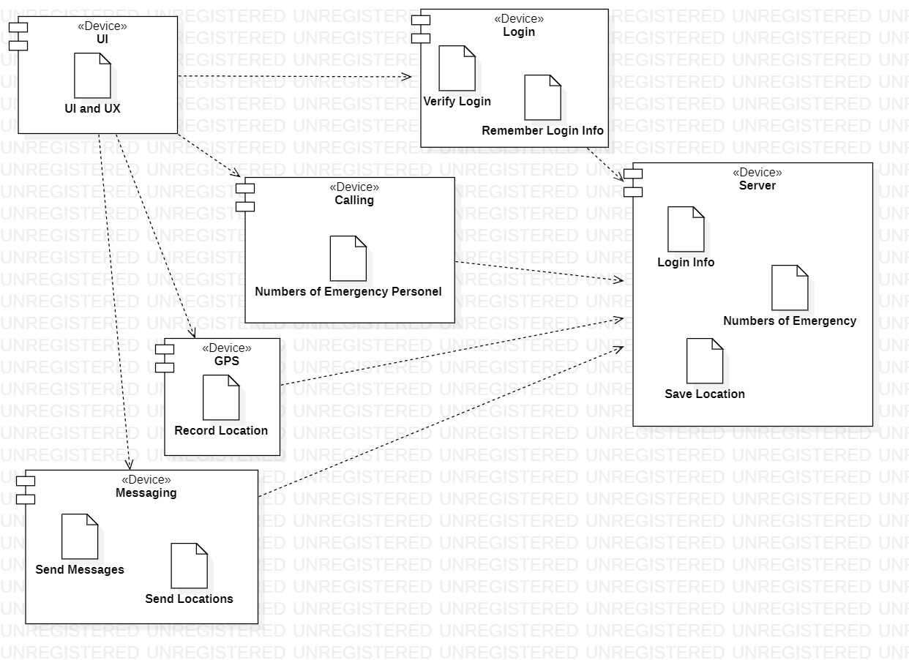
Deployment Diagram
The user Logs in using the ID and password which is then verified from the server. Once Verified the location
services is turned on and the location is saved in the servers. When the user decides to call the Emergency Services location services retrieve the location from the server and sends it to the required Authorities.

Slide 21
Software Demo

Slide 22
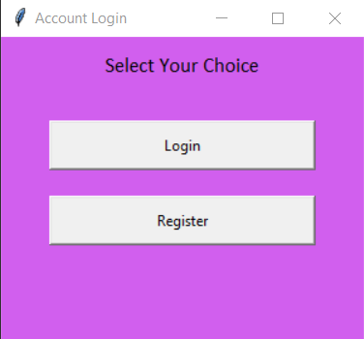
1.Login Page

Slide 23
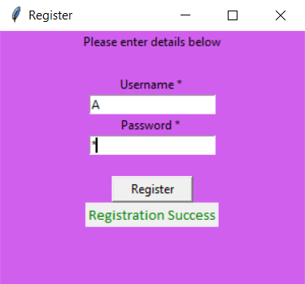
2.Registration Page(For New user)

Slide 24
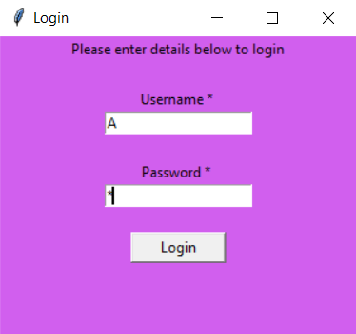
3.Login Page

Slide 25
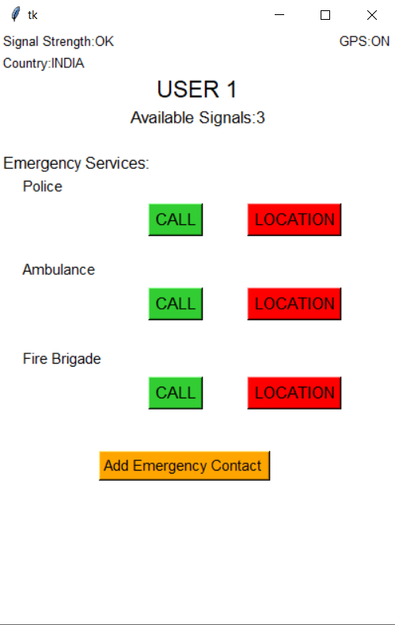
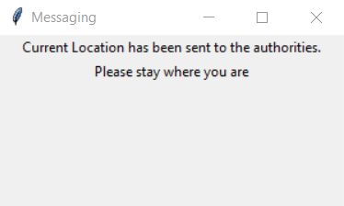
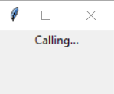
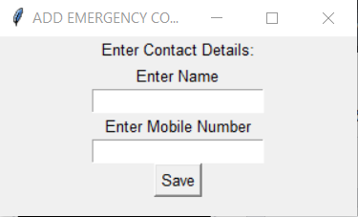
4.Main Page

Slide 26
Test Cases

Slide 27
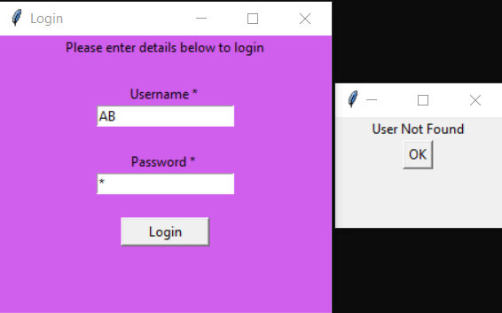
Test Case 1:
When User is not recognized(New User)
Problem Desc:
When the user is not recognized by the software, i.e, new user
Real Outcome:
Expected Outcome:
The software successfully sends an error message

Slide 28
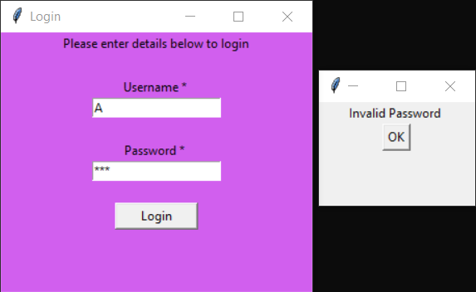
Test Case :
When password entered is incorrect
Problem Desc:
When the password entered by the user is incorrect
Real Outcome:
Expected Outcome:
the software is successfully sends an error message

Slide 29
THANK YOU
TEAM WORK BY
Ratnangsu Chatterjee
Harsh Tiwari
Sima Bharti

